Slide 1


Mind Management Skills Workshops
Getting Through Uncertainty

Slide 2
Housekeeping
Today’s workshop will run for 90 minutes and is designed to be interactive – we encourage participation
Confidentiality – you are not expected to share anything that you do not want to, anything disclosed will be kept confidential within the group – please see confidentiality rules for further information
Please be respectful of other group members who may choose to share their experiences – maintain the confidentiality of the group

Slide 3
Further Support
The workshops are designed to be skills-focussed, rather than problem-centred. However, if any of today’s discussion or exercises cause you to experience distress, you may wish to pursue further support
Full details can be found in the supporting information you received before this workshop
  Accessing the Student Health and Wellbeing Service
  Listening services such as the Nightline and the Samaritans
  How to access evidence-based therapy through the NHS

Slide 4
Goals for today
Homework review
Understand what worry is
Understand uncertainty and explore our ‘tolerance’ to this
Exercises to help us manage worry and uncertainty more effectively
Practicing skills

Slide 5
Homework Review
Did you notice mood changes – were you aware you were experiencing negative thoughts? Were you able to notice how you were responding?
Were you able to generate alternative thoughts?
Were you able to modify your behaviour to a more helpful response?
Feedback

Slide 6
Why this workshop for postgraduate students?
To help us design our mind management workshops we ran focus groups with post graduate volunteers to hear their experience of common issues which affected their wellbeing during their studies.
One key theme that came out of our focus groups was the transition to less structured ways of studying, which means navigating your workload independently caused a lot of uncertainty. This was linked to being uncertain about what is expected of you i.e. from your supervisor, causing pressure to overwork.
Many students reported they struggled without reassurance, which led to procrastination or focusing on more tangible tasks which increased anxiety regarding their studies
We hope the following workshop will help you identify unhelpful worrisome thoughts around uncertainty and patterns of behaviour, and offer some solutions to help you manage these more effectively
Notes:
Ask – who can relate to such issues?

Slide 7
Why this workshop for postgraduate students?
Student voice/experience – video?
Notes:
Show of hands who can relate

Slide 8
What is worry
A chain of negative thoughts, images and doubts about things that might happen in the future (things which are uncertain)
One worry leads to another creating a vicious cycle
Usually focused on worst case scenarios or outcomes
Notes:
People who experience worry are often in the form of ‘what if’ thoughts about things that may happen in the future. Worrying can seem helpful at first to reduce the anxiety that the person experiences. Worrying too much though can interfere with their ability to do everyday things
People usually worry about everyday events and things close to the person such as family, health, finances, work etc. Its often the case that you may worry about multiple things at a time, but generally these may go through periods according to what’s going on your life. So I’m sure most of you if not all of you have experienced worry and anxiety about your current postgraduate studies. Often this can lead to high levels of stress and more anxiety about the fact you are stressed, i.e. worrying that your stress is getting out of control
Also people can become preoccupied with the idea of not being worried, as if they are worrying things become more certain and controllable – by thinking and predicting the future you are somehow ascertaining some control over it
So for the most part, worres tend to be future focused concerns about things which have not yet occurred, but that might happen – hence ‘uncertainty’ – this is why we are exploring what worry is and defining it, as worry is often the behaviour we engage in to manage uncertainty.
What emotion do you associate worry with? (anxiety).. Ask Q
But when we worry, one thing tends to lead to another, which creates a vicious cycle of worry and a whirlwind of negative thoughts about bad things which could happen
This whirlwind of thoughts may be so stamped on the way we think we may not even notice it is happening.

Slide 9
What is worry
Worry is what we do normally in response to uncertainty
It’s a behaviour – i.e. its something we ‘do’ or engage in, despite being a mental process
Its purpose is normally to ascertain some sort of control or ‘certainty’ on whatever the feared scenario is we are worrying about

Slide 10
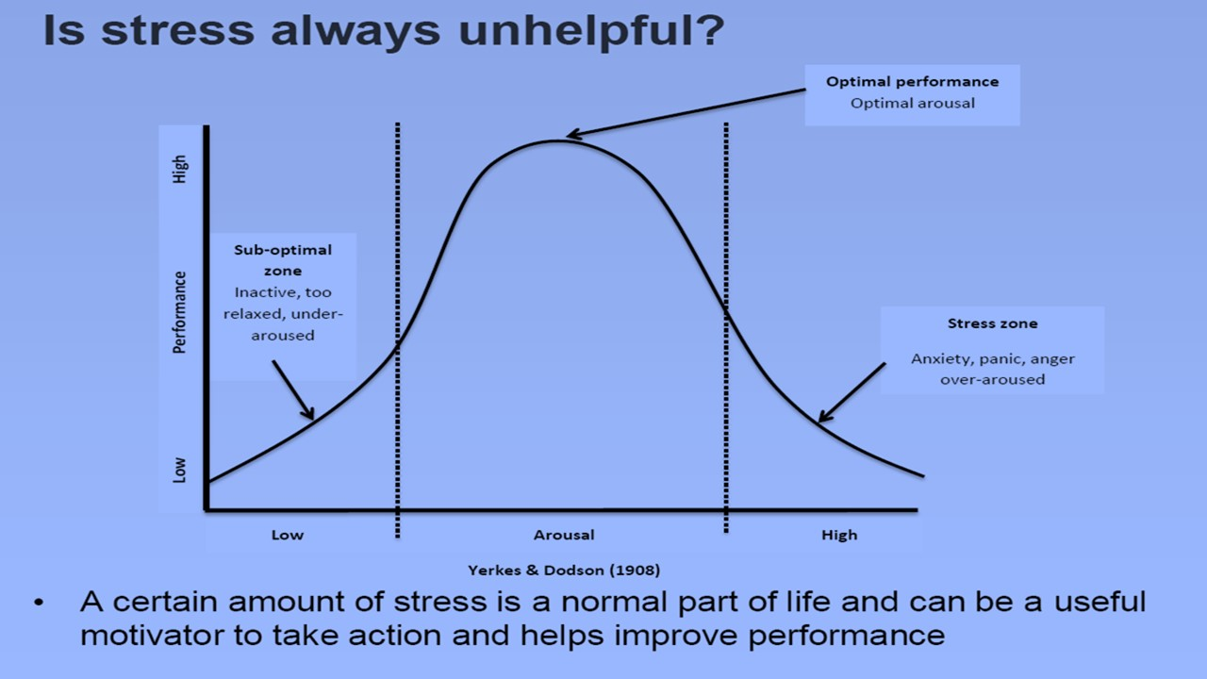
Is worry/anxiety helpful sometimes?
Notes:
Worry is normal? What do you think? (put to group)
We all worry at times, but worry itself can become a problem when it doesn’t lead to any helpful action. At times, no worry could potentially do more harm than good, and cause you to become too relaxed and inactive. E.g. if you had an important exam and you didn’t worry about it at all, you may not revise and go in unprepared, meaning you get a worse grade. So in this instance, worry may be useful as it prompts you into action = revising. Worry is unhelpful when it is excessive, disproportionate to the circumstance and does not result in any productive action for the concern. If we are too stressed, it affects our ability to engage with task in hand effectively as we are too wired, likely to result in burn out and exhaustion.
Normalising the way you feel can be very powerful, doing a PHD or studying at post graduate level is not meant to be stress free, your supposed to be feeling a little anxious., there is a lot of uncertainty to tolerate. Where are you on the worry gauge?

Slide 11
A Vicious Cycle of Worry
Situation/Trigger
Zoom meeting with sponsors
Thoughts/Images
What if they think I have not done enough, what if my work is not up to standard? What if what I have done is completely wrong? They will think they gave the grant to the wrong person, they will pull the plug on the project, what will I do then? I will fail, I will never have a career or be successful
Emotions
Anxious, worries, scared, fear
Physical Feelings
Stomach butterflies, on edge, tense
Behaviours
Worry, imagine worst case scenarios, seek reassurance from peers, mentally ‘prepare’
Notes:
So worry can be helpful when it prompts to be alert to something happening in our lives and take some sort of action, but when anxiety and worry is too high it can become unhelpful and fall into that vicious cycle we were talking about earlier
People can feel trapped in a vicious cycle of worry and anxiety. For example they may feel they have lots of physical tension and feel on edge. It can affect your sleep, or make you feel more irritable around others
Worry and uncertainty impacts all of these areas and one thing leads to another. E.g. worrying can lead to increased tension and anxiety, which in turn can lead to avoiding situations that are anxiety provoking, uncertain, unpredicatable or hard to control. It may also cause a person to over prepare for things, spending lots of time rehearsing and planning, or they may procrastinate and put things off. They may all also seek reassurance from peers and their superiors. These behaviours as a result of worrying may provide some short term relief, but in the long term may maintain worry (could ask for feedback why? – A – because it reinforces the idea the cannot cope, or solve problems on their own, hence they will worry more.

Slide 12
Skills Practice 1 – Noticing when you are in a vicious cycle
Using handout 1 from week 1 ‘noticing when we are stuck’, recall the last time you were worrying
You might notice a lot of your thoughts begin with ‘what if’
Map out the interaction between your thoughts, emotions and behaviours when you were worrying
Notes:
Explore your common worrisome thoughts, how they make you feel, and what they cause you to do – think about your common triggers – a meeting with your supervisor? Getting stuck when you sit down to work? Not being sure what your goals are, not knowing when deadlines are, etc etc
Get as many worrysome thoughts from the whirlwind as possible –
EMPHASISE – its very important to notice when you are worrying as it keeps us stuck and caught up in thought (think back to the river analogy we have used) – when you are caught up your not looking at the present moment, and what needs to happen right now – so if I am worrying I might fail and what will I do after I fail? Im not attending to what needs to be done in the here and now, which is that I need to write a literature review, that is what needs my attention

Slide 13
Two types of worry
Hypothetical
Practical worries
Notes:
Practical worries are generally related to something affecting you now, for which there is a practical solution, for example ‘I have too much work to do’ or ‘I haven’t got enough money to pay my electricity bill this month’ – these are worries you may take action to now as the problem exists in the here and now – it is normal to feel some anxiety in response to such thoughts – this might be when yo decide to problem solve, prioritise and are able to actively do something about it
Use the boiler analogy
Hypothetical worries are generally related to something which may happen in the future and start with: ‘what if’, i.e. what if my supervisor thinks my work is rubbish. Although these worries may cause distress and you may dwell on them, there is no way of solving them. These worries tend to entail predictions of bad outcomes, i.e. my supervisor will fail me – these tend to be something you cant manage because the problem does not exist in the here and now, therefore only promotes more worry – identifying our worry can be helpful to chose how we respond – quickly look at your cycle – are your worries practical or hypothetical? Hypothetical worrying is normally a response to uncertainty – or things that might happen – we are going to focus more on managing these worries as they tend to keep us stuck (theres nothing we can do about them)

Slide 14
Uncertainty
Uncertainty is like hayfever in that when someone who has hayfever is exposed to a small amount of pollen, the body reacts with a huge response i.e. sneezing, red eyes etc. Everyone is different in their tolerance to pollen
Just like hayfever, we all have a varying tolerance of uncertainty, which can depend on different situations and contexts we may face in our lives. When faced with uncertainty, our body reacts, it can become tense, anxious, and we start to worry to try and gain some sort of control over the feared outcomes of our worries
0% tolerance
100% tolerance
Notes:
Say a little bit how uncertinaty is normal, much of life is uncertain, we don’t know what will happen tomorrow, but when something has a big stakehold in our lives, i.e. doing our exams, doing a postgraduate degree, moving house etc where outcomes are uncertain, we will worry about them. Again, this is normal, but when we cant tolerate this and attempt to action these worries to gain certainty it becomes problematic
Mention how in the focus groups post grad students stated they struggled to tolerate uncertainty in the supervisor relationship, i.e. not knowing what others think of us or what our supervisor thinks of us – there may be several different reasons why you are worrying about that which we will look at further
1 minute exercise, get the group to rate where they are on the tolerance of uncertainty gauge

Slide 15
Hypothetical worries and uncertainty
“How much pain they have cost us, the evils which have never happened”
Thomas Jefferson
Hypothetical worries are generally future focused predictions about what ‘might’ happen, regarding an outcome that is uncertain
They typically start with ‘what if’…
They are non-tangible (the problem does not exist in the here and now) hence they are difficult to action
Dealing with every single hypothetical worry you experience can be like playing ‘whack a mole’ in the arcade – it never ends and can become exhausting, and can lead to more severe anxiety difficulties
Notes:
Put to the group that it might seem simple, I can solve or action practical worries which ultimately resolute the anxiety I experience, and I cant action or do anything about hypothetical worries so I should just stop? Well, cant do anything about that… worry gone… why could it not be as simple as that?
As mentioned at the beginning of the session when we learned about our worries, we generally worry because we are trying to gain some certainty over uncertainty, i.e. some control – e.g. if I worry about being late for a meeting, I will leave 30 minutes early and then it is certain I will not be late – but the consequences of this are that you stressed, and you’ve lost 30 minutes of your day by predicting you will be late
Hypothetical worries are difficult to action, and if we deal with each single one, its like playing ‘whack a mole’ in the arcade (use analogy), therefore one of the skills we weill be focusing on is looking at the ‘process’ of worry – why you worry in the first place, because if you give worry a function – why stop? Now think back to the earlier exercise, i’m worrying about this because… if you believe the answer to that then why would you stop worrying?

Slide 16
Why we worry in response to uncertainty
“Worrying helps me to be prepared and solve problems”
“Worrying motivates me”
“Worrying protects me from feeling bad later”
“Worrying can prevent something bad from happening”
“Worrying shows I care”
“Worrying helps keep me safe”
Do any of these statements sound like you?
Do any others spring to mind?
Notes:
If we believe that worry is helpful in some way – then why stop? We have to learn that worry is futile and unhelpful – we learn quick as humans – once we learn something doesn’t work we tend to stop doing it
What would be the function of worrying about what your supervisor thinks of you ‘what if my supervicor thinks I am rubbish’ – does it get to you work harder, people please, mean you will get a better grade?
We are now going to generate an alternative to how useful worry is – its different to how we have generated alternatives in the previous sessions, as we don’t want to generate an alternative thought by looking at evidence for and against it – because we don’t want to engage in the thought as that would be engaging with worry! You will be WORRYING! What we want and are looking for here is to generate an alternative view on how useful worry is, if we no longer believe it is useful we can disengage from it

Slide 17
Generating Alternatives to the usefulness of Worry
1. Notice or “pin down” the worry and consider why you are worrying about it
“I am noticing that I am having the worry ‘what if I fail’?”… “if I worry about failing now I will be better emotionally prepared for it when it happens”
2. Question the usefulness of worrying about it
Has worrying emotionally prepared me for things before? How has this belief helped me before? Has it ever worked? When has it not worked
“Worrying about this is hypothetical and distracting me from the future, every time I have worried about this before the outcome is never how I imagined it to be in my head, if I fail I will be just as upset, if not more than I am now just worrying about it”
3. Generate a more balanced thought that fits the situation
Notes:
Remind not trying to get evidence for and against the thought what if I fail, what will I do after? We wan to STOP WORRYING and break free from this chain of thoughts –
Have you ever worried about something so much that the outcome actually looked nothing like what you imagined?

Slide 18
Skills Practice 2 – Generating alternative to the usefulness of worry
Take one of the prior statements that resonates with you from the previous slide
Consider when this belief has worked for you
What facts do you have to support this usefulness of worry
When has it not worked
Consider when you notice you are thinking this way… do you believe it?
Considering this generate an alternative as to how useful worry is

Slide 19
Behavioural Response to Uncertainty
Active
Over working, doing everything yourself
Gathering lots of information and preparing prior to attempting something
Going over and over work and/or other things, checking
Seeking reassurance
Taking control, perhaps doing things for others
Passive
Procrastinate, put things off
Ruminating over past events rather than focusing on the here and now
Avoid fully committing to things
Finding ‘excuses’ to not to certain things
Notes:
Explain that typically we fall into 1 of 2 behaviour patterns – you approach it – try to control it – or, you avoid it – what do you do in your worry?

Slide 20
The importance of behaviours
Possible Function (intended consequence)
If I work really hard, check all sources of information and check my work over and over I will not fail – I can be more certain I will not fail (outcome)
Get temporary relief from distress and uncertainty – ‘If I don’t do it then the outcome is certain’
Worry / thought
“What if I fail, I wont get a job after my PHD”
Emotion: Anxious
Unintended consequence
Burnout, anxiety, stress zone
Low Mood, more worry.
I don’t learn I don’t fail without the behaviour
Behaviour
Overcompensate, (more hours spent working) [approach behaviour]
Procrastinate, avoid task at hand [avoidance behaviour]
Notes:
Its not so much having the thoughts that is the problem – as we have previously explored, thoughts are important in our emotional states , but we for the most part cant control our thoughts, therefore its what we do in response to our thoughts which give us the greatest power
Everything we do, (coffee example) e.g. including engaging in thoughts (ruminating over the past, predicting negative outcomes) has a function – a consequence we intend, but many behaviours can also have consequences we don’t intend

Slide 21
Skills Practice 3 – Changing Behaviour
Look back at your earlier thoughts feelings and behaviours map, was your behaviour an active or passive behaviour in an attempt to manage uncertainty?
Using your hand out (3) in your groups of 3-4, consider:
What was the function of what you were doing?
  What was your intention in this behaviour?
  What were the possible unintended consequences of this?
  What would be a more helpful behavioural response?
Notes:
Either or you are trying to manage a response to uncertainty – either control it, or avoid it so you can still have control. We ideally want to increase our tolerance to uncertainty – welcome it
Feedback

Slide 22

Changing Behaviour
Worry is a behaviour – it’s a mental process which we spend time engaging with
We have control over our behaviours, we can disengage from our worries and chose to pay attention to what needs to happen right now
We can increase our tolerance to uncertainty
Notes:
De-centering from thoughts and chosing more helpful action to be in the present
Highlight that if we chose to engage in the worry process – it makes us feel bad, so we want to chose to disengage from this trail of thought, in this way we increase our tolerance of uncertainty, because we stop trying to gain control over it
We can increase our tolerance to uncertainty – we need to! So much of life is uncertain, you don’t realise but you tolerate uncertainty all the time, accepting it is part of our lives and choosing to not try and control it is the biggest power – uncertainty can be exciting – its like Christmas day!

Slide 23

Choosing to do different
Thoughts and worries are like a river. You can either dive in and follow them, or stand on the bank and notice they are happening, and chose how to respond

Slide 24
Worry is normal, even sometimes helpful if it spurs us into action
Studying at postgraduate level is not supposed to be stress free
If we learn worrying is unhelpful it can help us disengage
Uncertainty is difficult to tolerate, but trying to control this has unintended consequences.
Worry is behaviour, it’s a mental process which we engage in, which we can choose to respond differently
Key Messages
Notes:
Helpful when it spurs us into action but not when we cannot action a worry which will take away or reduce the distress

Slide 25
Homework
When you notice you are worrying remind yourself of your alternative belief about the usefulness of worry
Implement your new, helpful behavioural response
Bring your attention back to the task at hand
Notes:
Will they use a stratedgy in response to one particular trigger or scenario?? How will they evaluate it? How will they know if the workshop has helped in 1 months time? What do they need to keep practicing

